Slide 1


Optica Eyeglasses
E-Commerce Website
April 16, 2025
PE075DS (13)

Slide 2

Project Requirements
Plan, design, and develop a business website with 15 or more pages
Implement front-end functions
Connect all data to the server for database access
Use application technologies: HTML, CSS, and JavaScript for functionality

Slide 3

Project Objectives
Construct a user-friendly website
Enhance customer experience
Ensure maintainability
Support scalability for future growth
Facilitate continuous improvement

Slide 4
Why Eyeglasses?
Growing Market: Rising demand for eyewear fueled by online shopping trends.
Convenience: Consumers enjoy the ease of purchasing eyeglasses online.
Wide Selection: Online platforms offer a vast array of styles and brands to suit diverse preferences.
Price Competitiveness: Lower overhead allows online retailers to provide better prices and promotions.
Accessibility: Online shopping reaches individuals in remote areas with few optical stores.

Slide 5
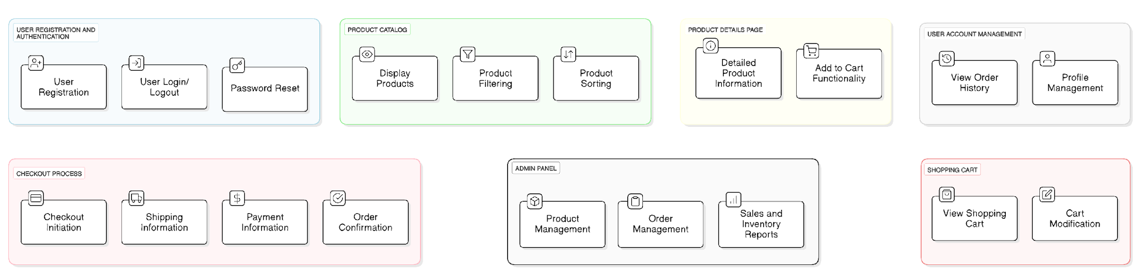
Functional Requirements

Slide 6


Project Timeline
Design
Testing
Marketing and Promotion
(March 15 - March 28)
(April 14 - April 15)
(April 17 - June 24)
Planning and Research
Development
Deployment
Ongoing Monitoring
(March 1 - March 14)
(March 29 - April 13)
(April 16)
(April 17 - Ongoing)

Slide 7
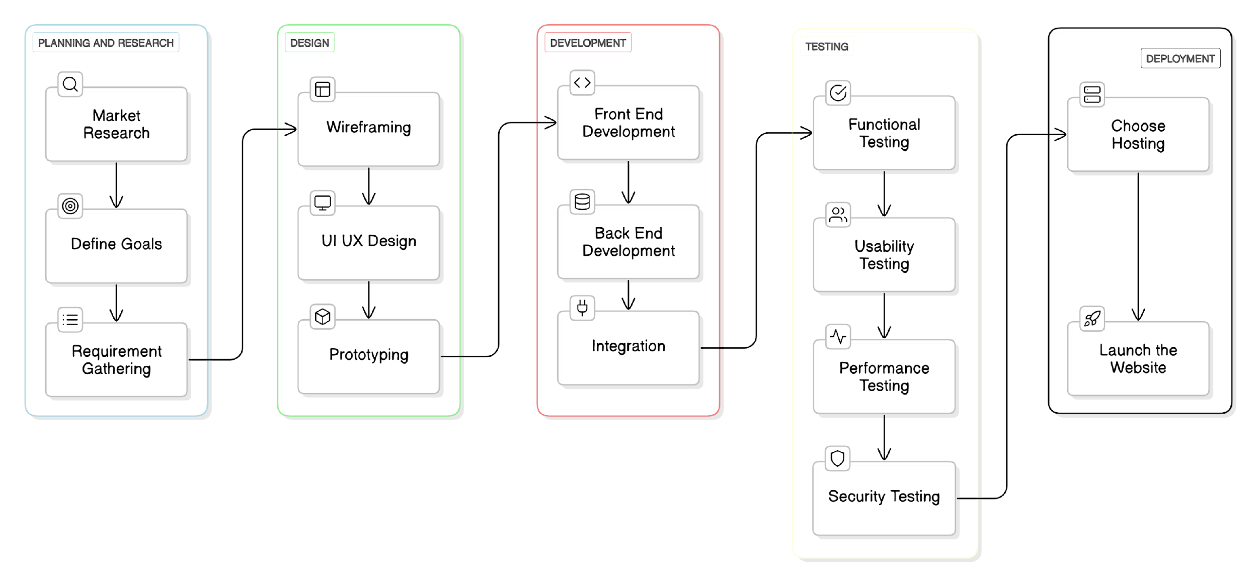
Project Workflow

Slide 8
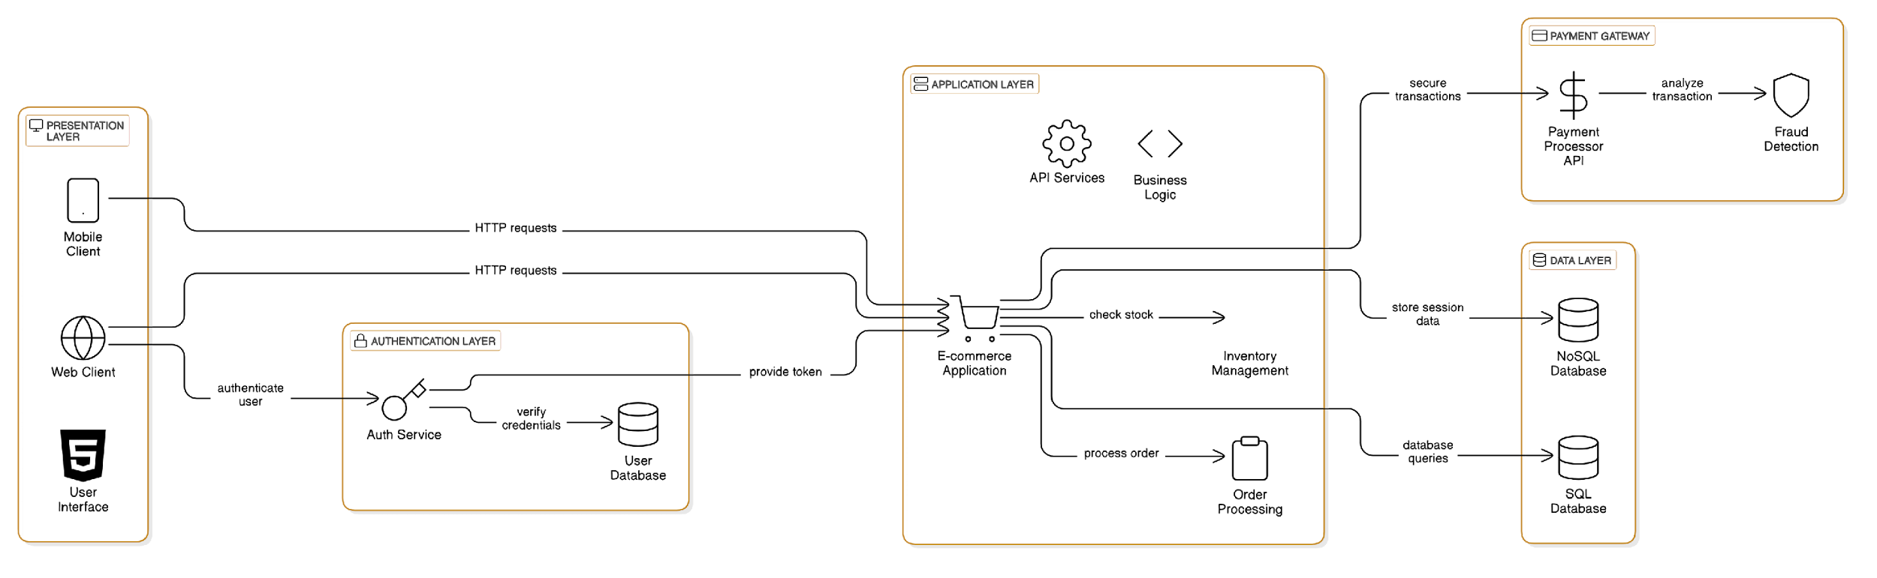
System Architecture

Slide 9
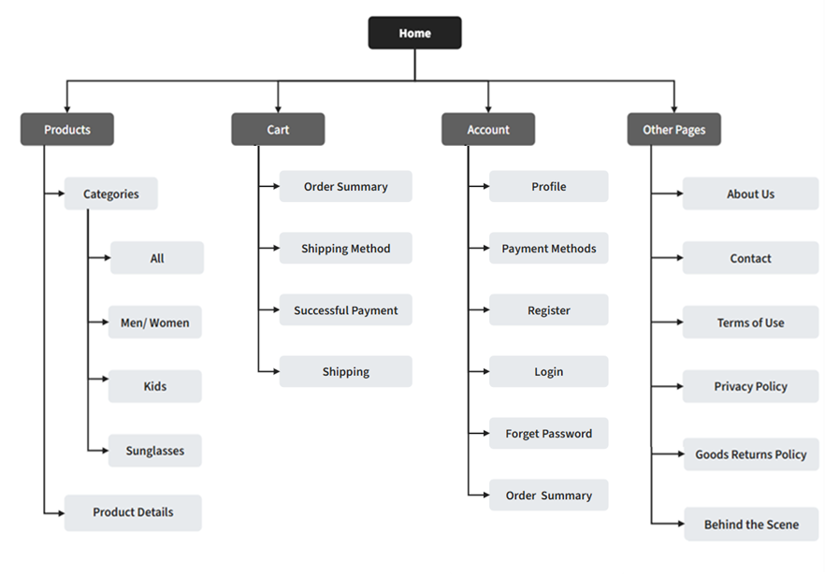
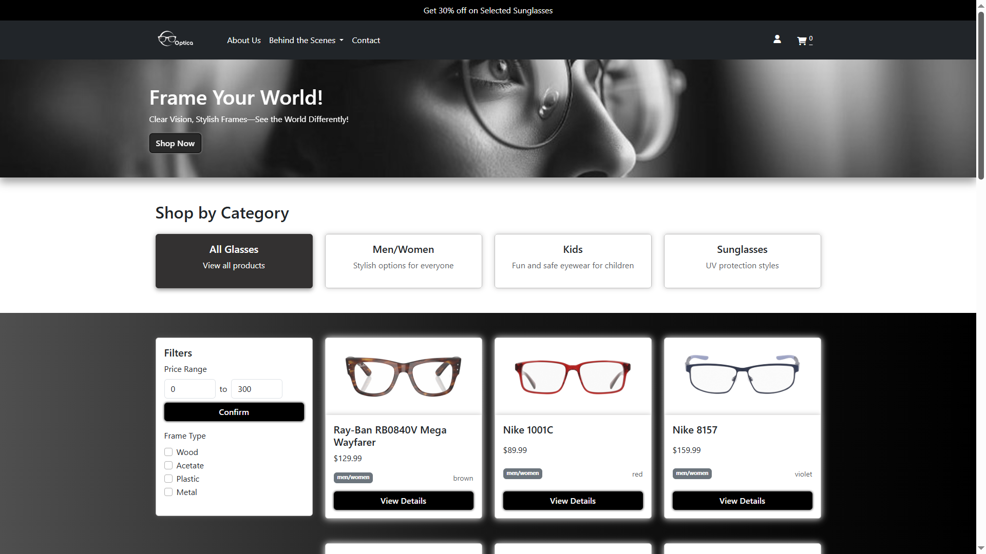
Site Map

Slide 10
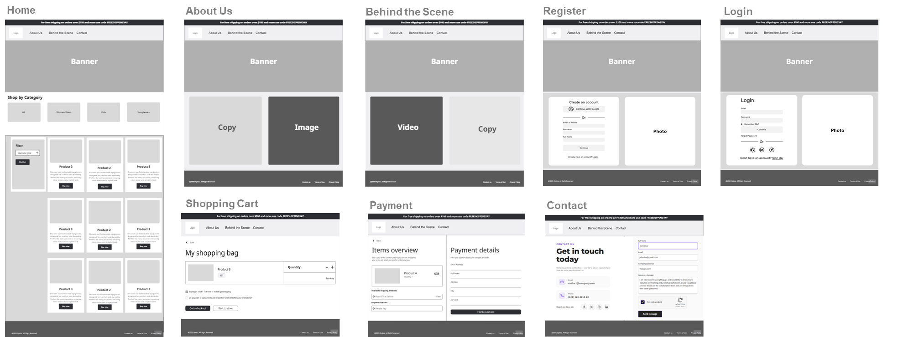
Wireframe
Low Fidelity Prototyping

Slide 11
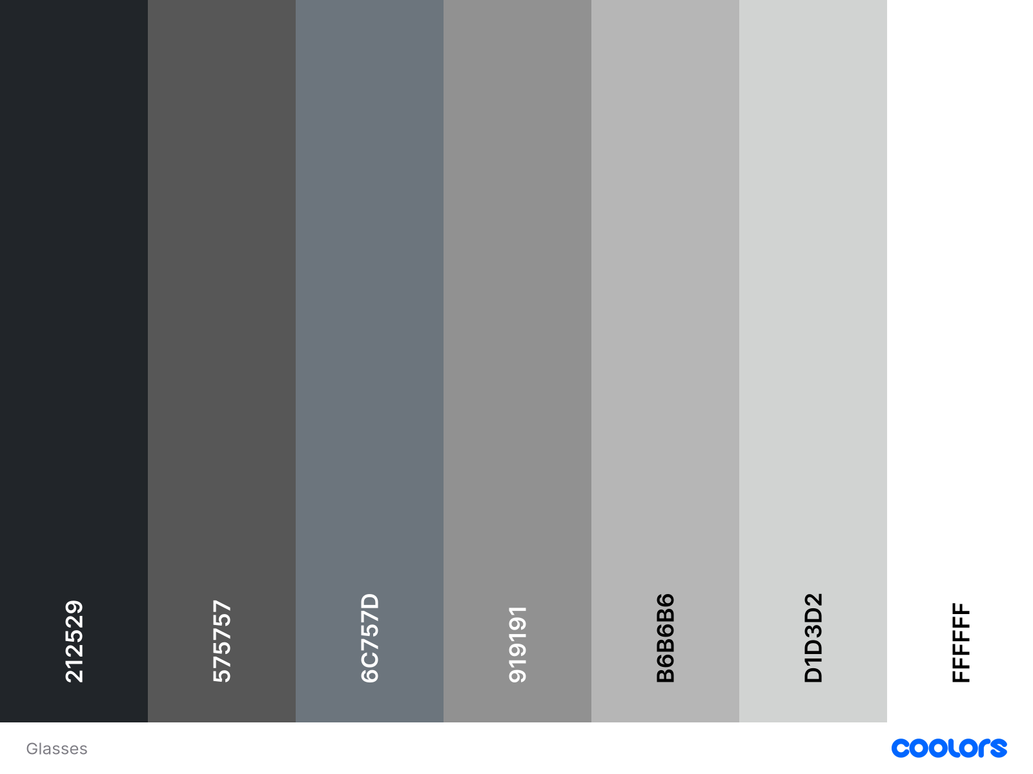
Color Palette

Slide 12
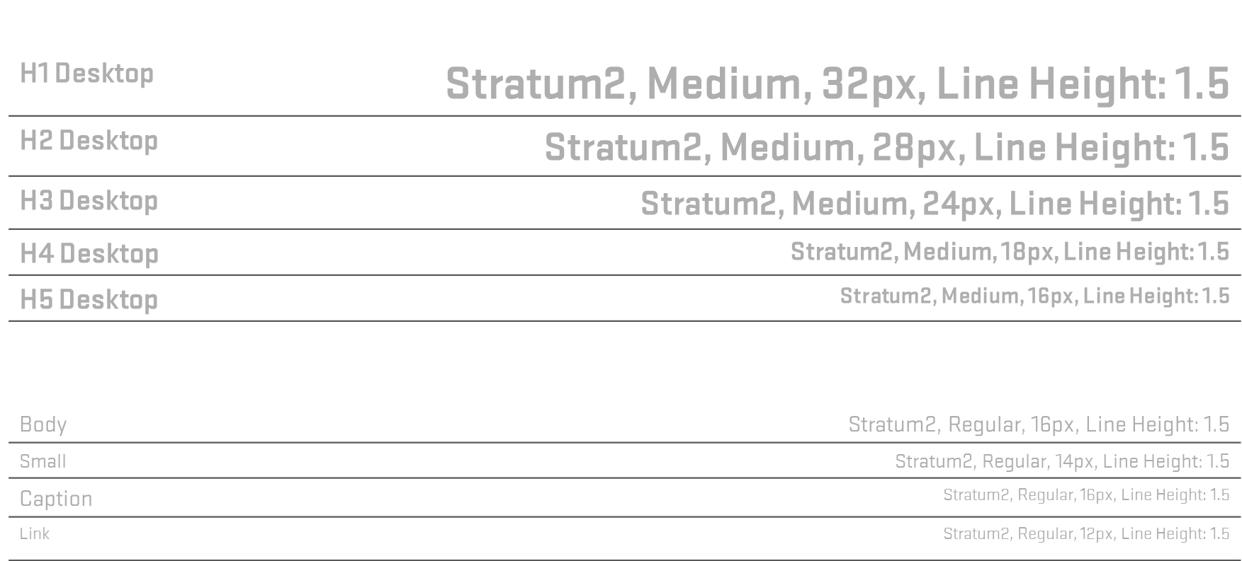
Typography Style

Slide 13
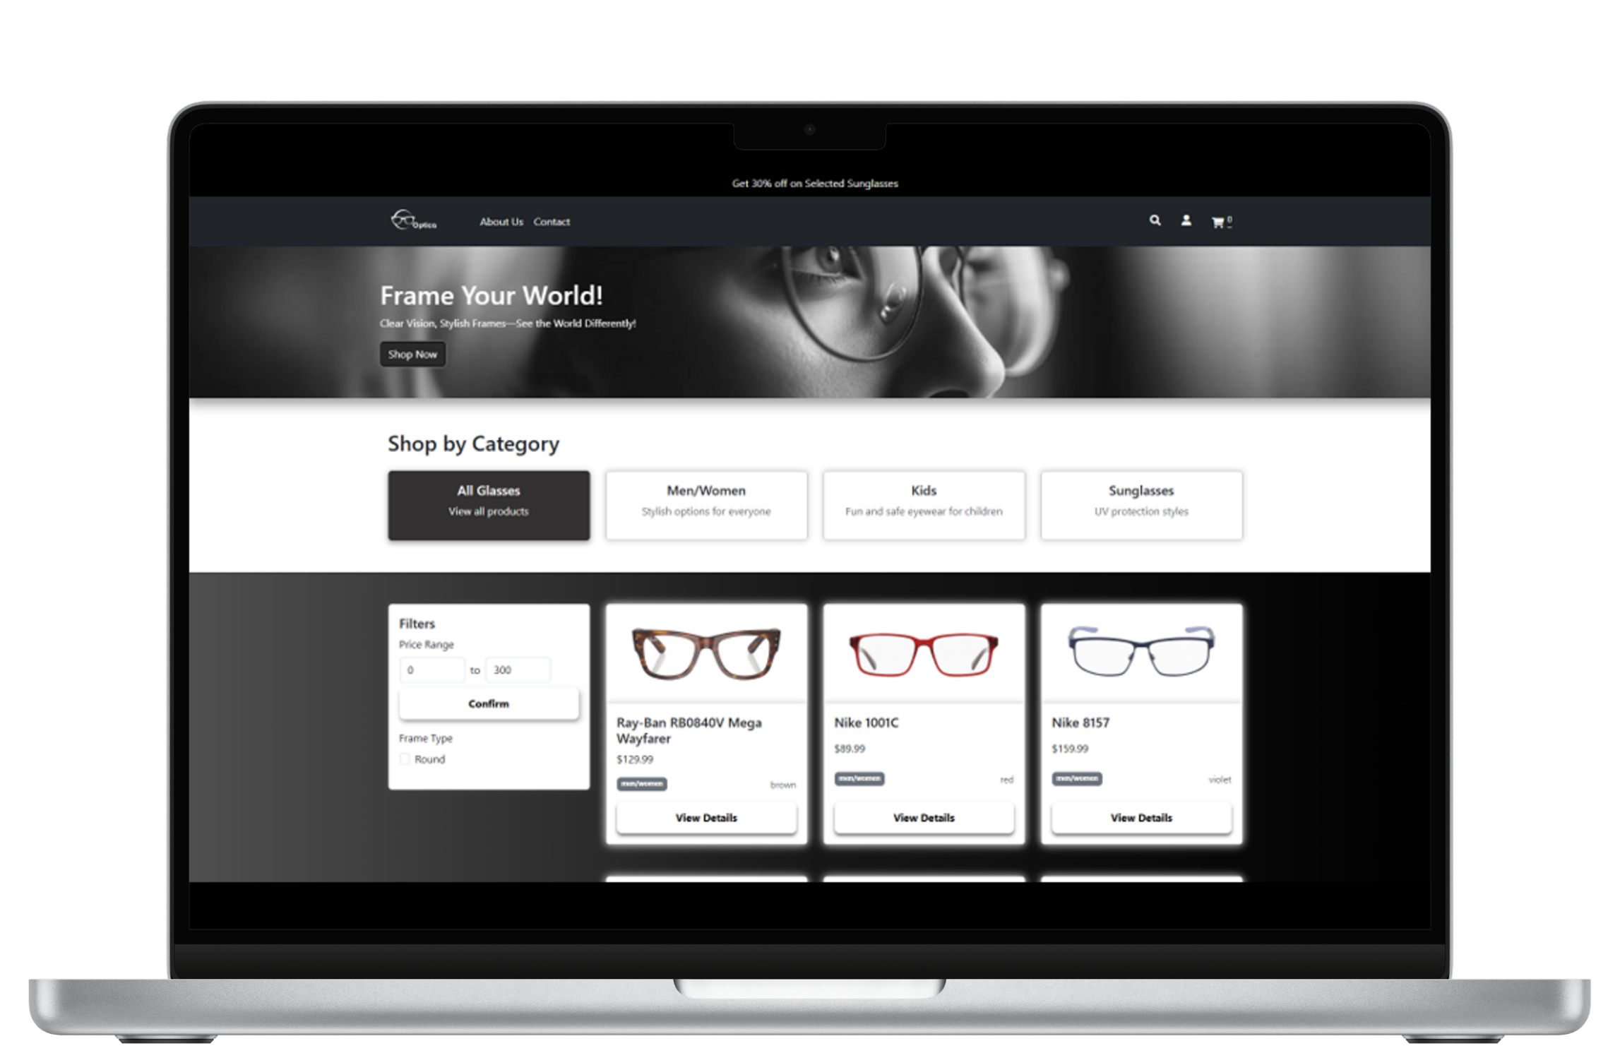
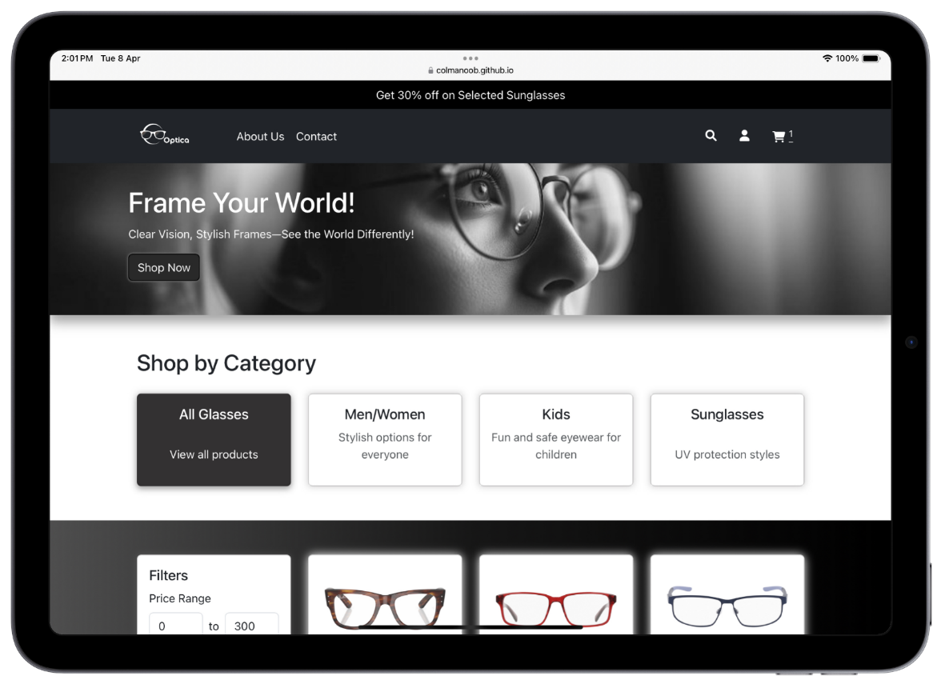
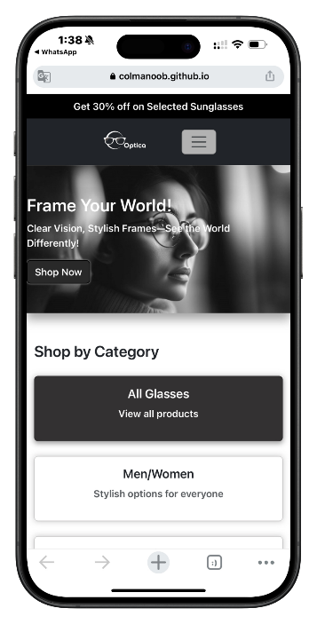
Responsive Design

Slide 14

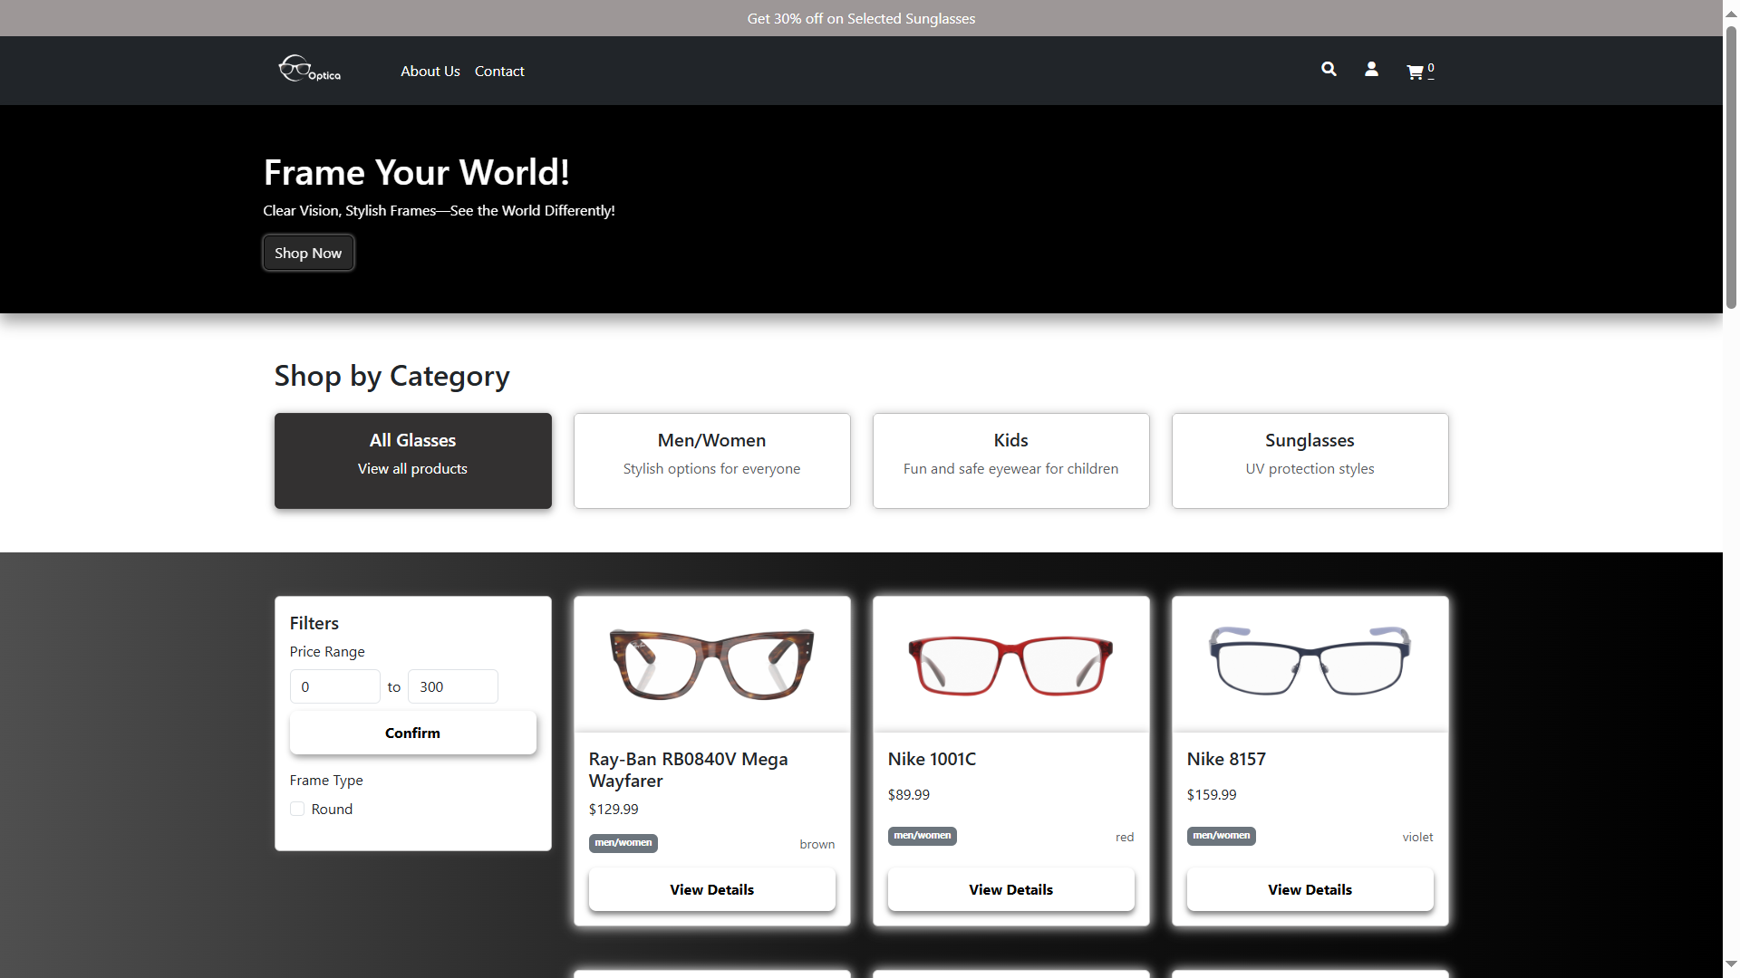
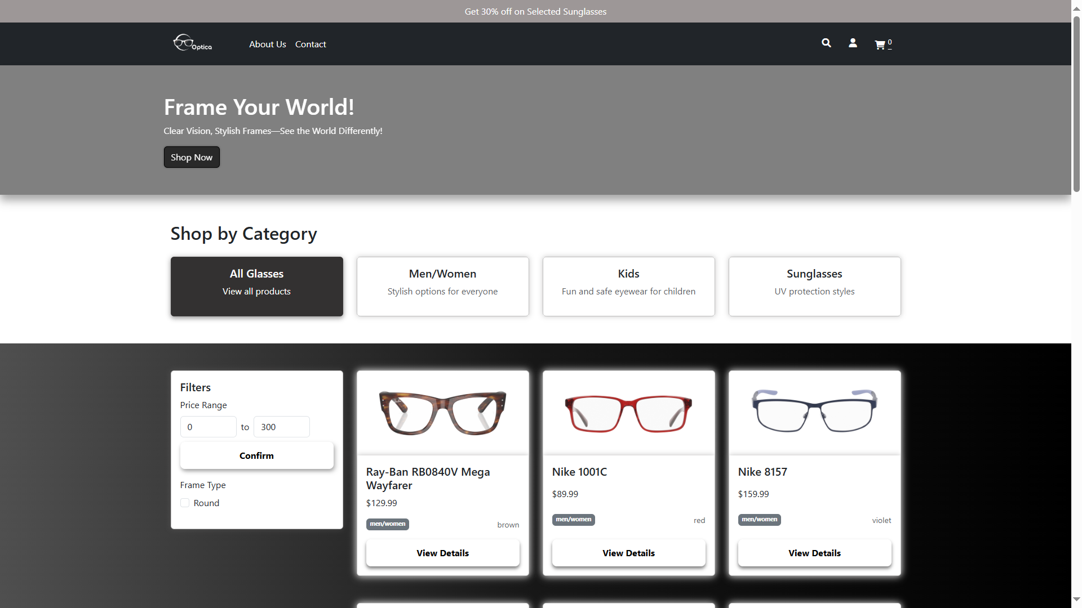
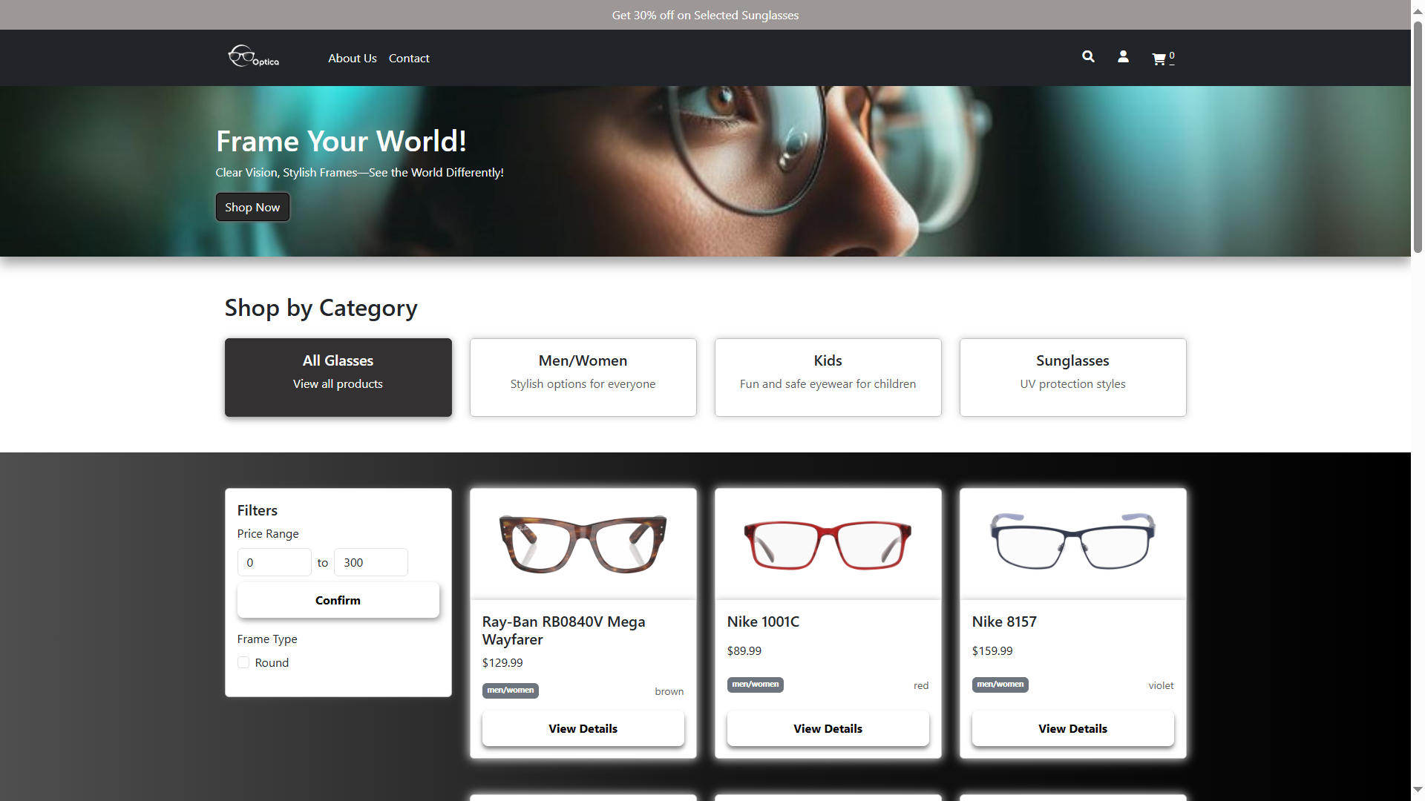

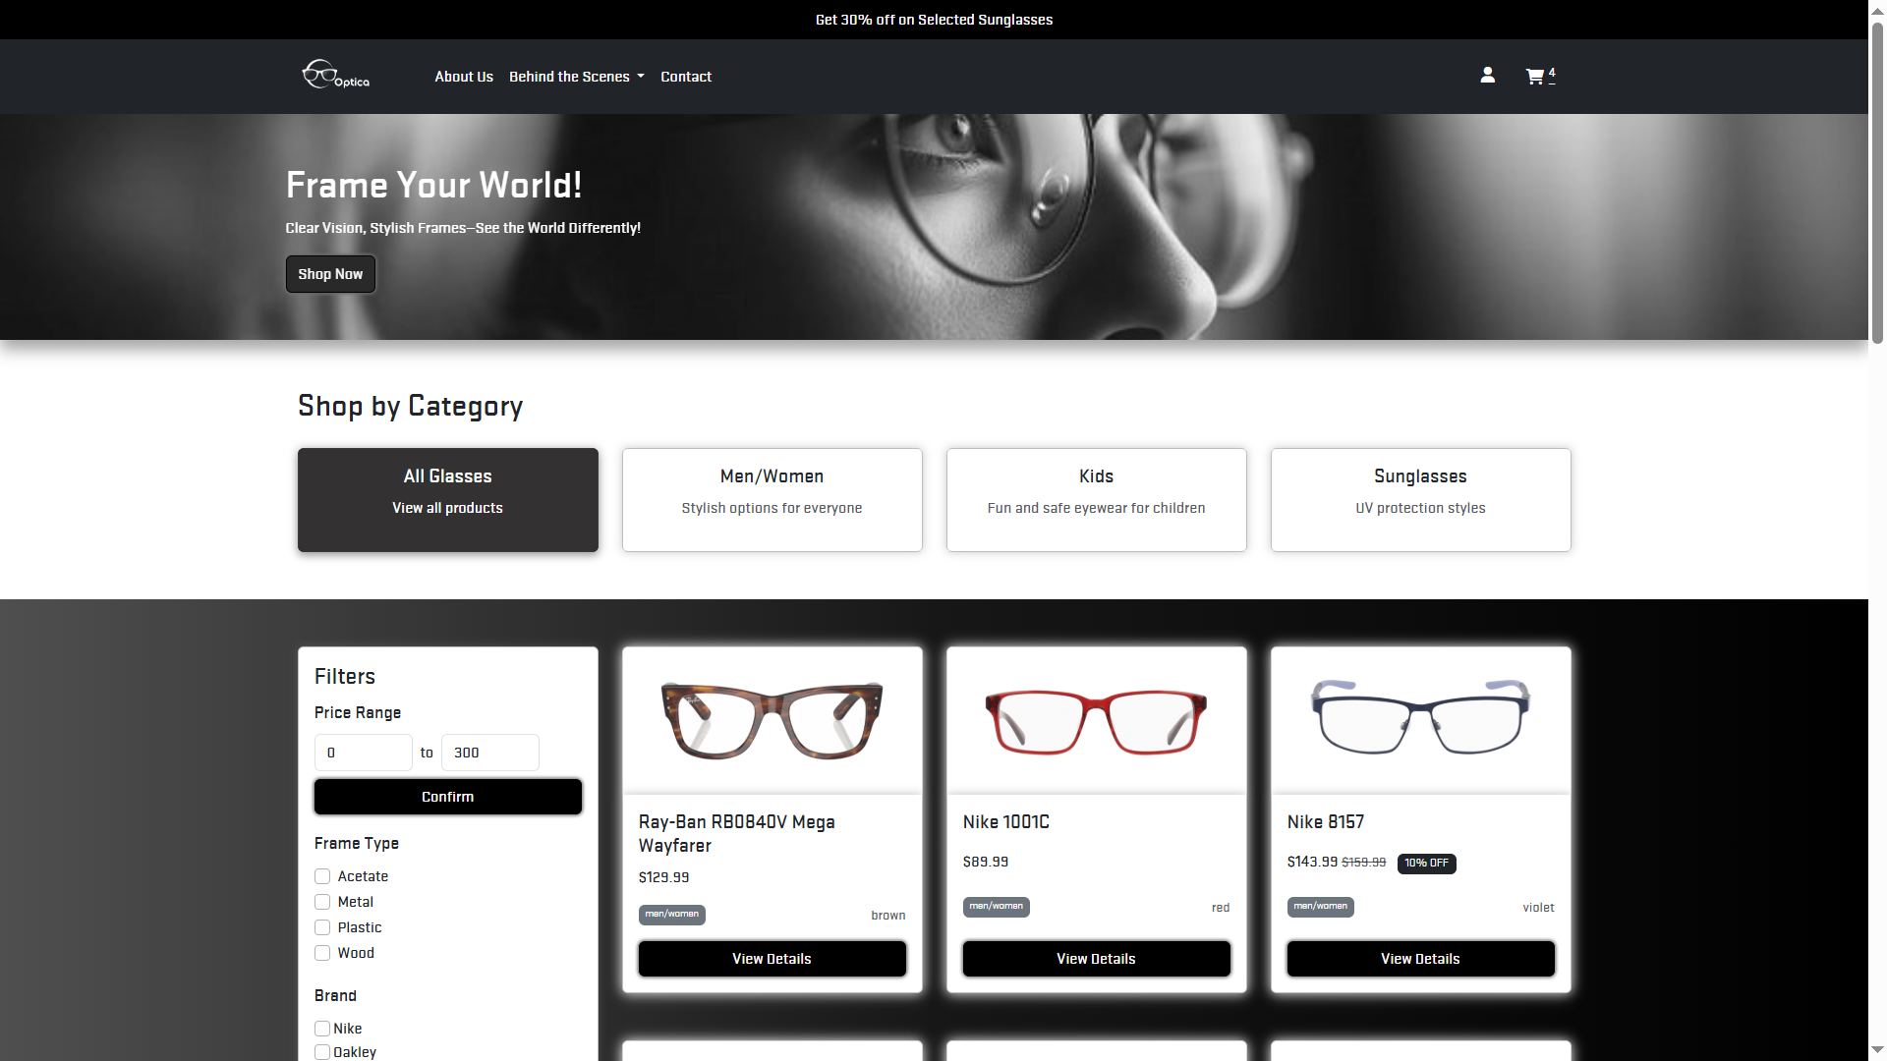

High Fidelity Prototyping

Slide 15
Demo

Slide 16

Testing And Refinement
Unit Test
Functional Test
User Acceptance Test (UAT)
Responsiveness
Feedback and Issue Reporting
Refinement
System Integration Testing (SIT)

Slide 17

Learnings
Teamwork: Enhanced collaboration and communication skills.
Research Skills: Improved market research abilities to inform design choices.
Technical Skills: Gained proficiency in web development and eCommerce technologies.
User Experience Focus: Emphasized the importance of an interactive, user-friendly interface.

Slide 18

Conclusion
The "Optica" Eyeglasses online store project successfully created a responsive and user-friendly eCommerce website.
The team effectively differentiated the site from existing competitors through unique design and features.
The project highlighted the importance of thorough research and collaboration in achieving project goals.

Slide 19



The Team
LO Ka Man
HEUNG Chee Leung, Ivan
LAM Tai Yuen
TSAN Siu For
CHAN Chun Hei

Slide 20
Thank You !

